Slide 1
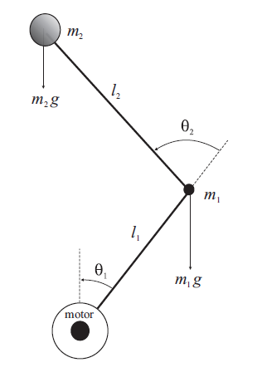
Control System Lab Rotational pendulum 3.2
Nick Tsutsunava
Dick Nieuwenhuizen
- Physical system
- Black box model
- Simulink model
- Linearisation
- Parameter estimation
- LQR controller
- Kalman filter
- Simulation + visualization
- Demo

Slide 2
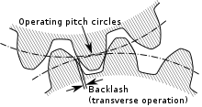
Physical system
Inverted input compared to model
CW rotation positive for theta1 and theta2
Gain offset for theta2
A lot of backlash in the system. Backlash is caused by distance between the overlapping teeth of gears.
- Physical system
- Black box model
- Simulink model
- Linearisation
- Parameter estimation
- LQR controller
- Kalman filter
- Simulation + visualization
- Demo

Slide 3
Black box model
First tried to use generalized binary noise (GBN) input for estimation of both states, later for only theta2
ARMAX and OE fit made, OE proved to be better (68% fit)
Backlash messed up the fit showed in validation
Estimated using constant input and taking data from only around the linearisation point, good fit (95%) and seemingly correct validation
Not able to design a controller for this
- Physical system
- Black box model
- Simulink model
- Linearisation
- Parameter estimation
- LQR controller
- Kalman filter
- Simulation + visualization
- Demo
Notes:
Ended up with 10x10 state matrix wanting to estimate the model for both outputs

Slide 4
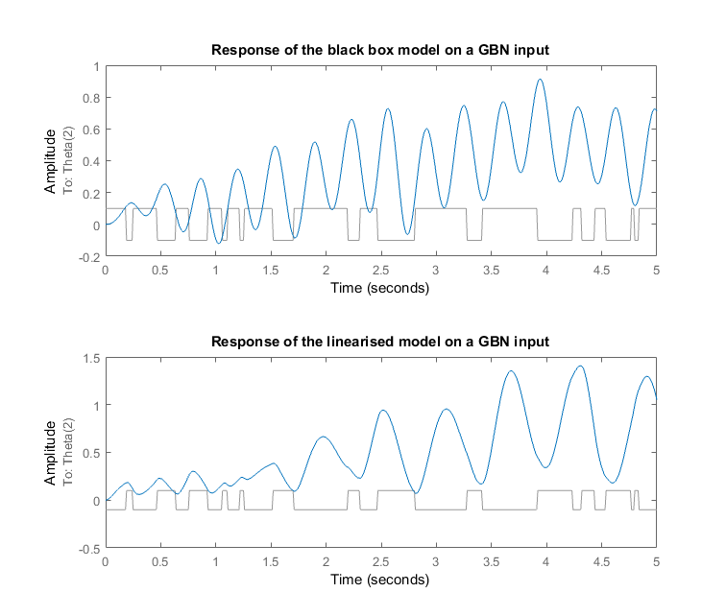
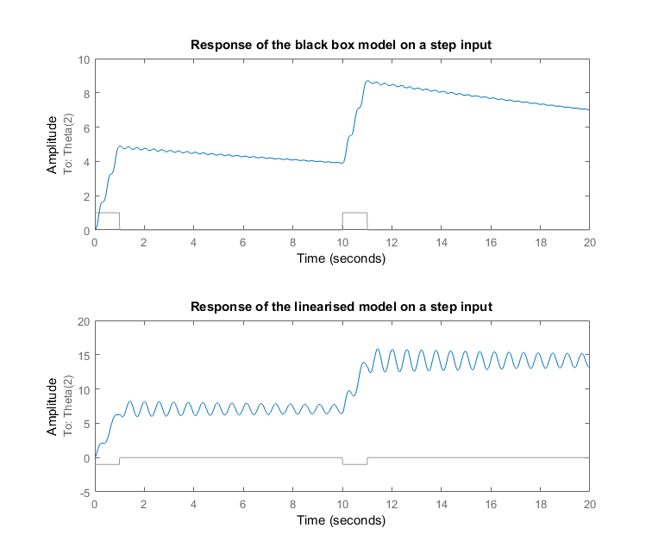
- Physical system
- Black box model
- Simulink model
- Linearisation
- Parameter estimation
- LQR controller
- Kalman filter
- Simulation + visualization
- Demo

Slide 5
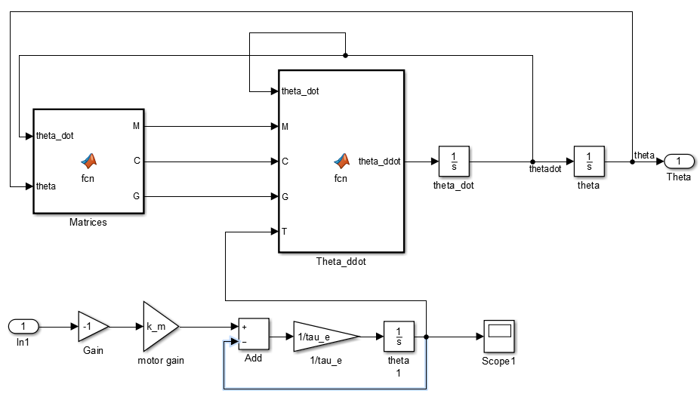
Simulink nonlinear model

Slide 6
Linearisation
Linearisation made by use of linearize in Matlab and by hand.
Defined operating point and input and output ports
Did not give exactly the same result, but did give the same eigenvalues. So linearisation by linearize was verified.
- Physical system
- Black box model
- Simulink model
- Linearisation
- Parameter estimation
- LQR controller
- Kalman filter
- Simulation + visualization
- Demo

Slide 7
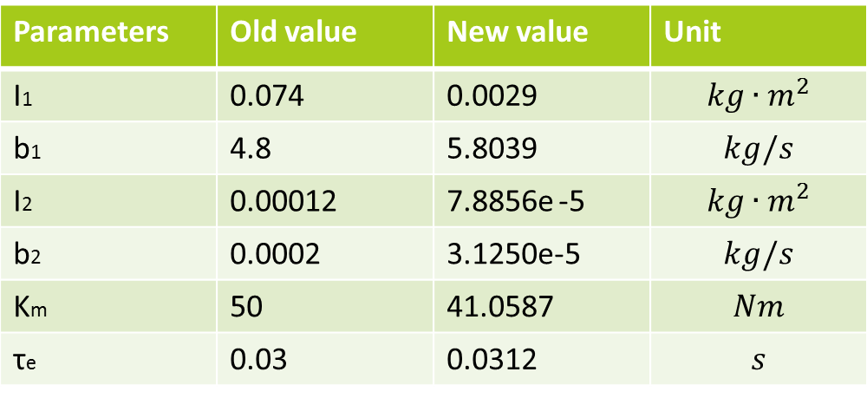
Parameter estimation
First parameters of link 2 were estimated using lsqnonlin in Matlab.
Upper bound was set to guide the optimization in the right direction.
These were used as initial guess for estimation of link 1 which leaded to:
- Physical system
- Black box model
- Simulink model
- Linearisation
- Parameter estimation
- LQR controller
- Kalman filter
- Simulation + visualization
- Demo
Parameters | Old value | New value | Unit
I1 | 0.074 | 0.0029 | $$kg∙m^{2}$$
b1 | 4.8 | 5.8039 | $$kg/s$$
I2 | 0.00012 | 7.8856e -5 | $$kg∙m^{2}$$
b2 | 0.0002 | 3.1250e-5 | $$kg/s$$
Km | 50 | 41.0587 | $$Nm$$
τe | 0.03 | 0.0312 | $$s$$

Slide 8
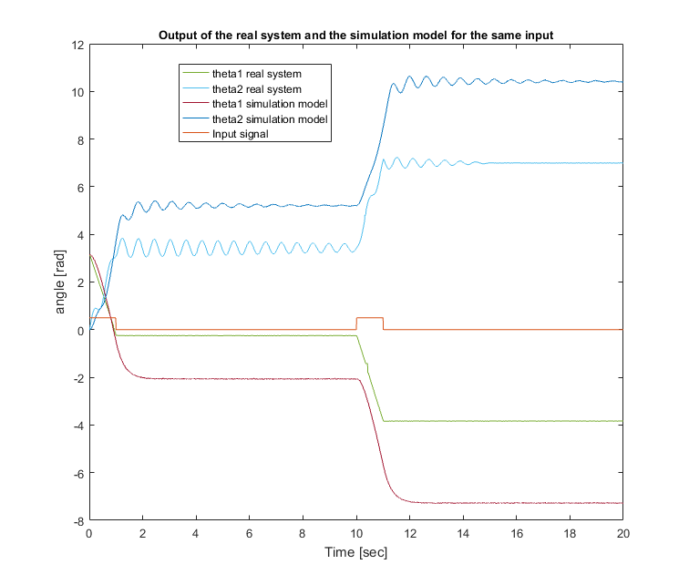
- Physical system
- Black box model
- Simulink model
- Linearisation
- Parameter estimation
- LQR controller
- Kalman filter
- Simulation + visualization
- Demo

Slide 9
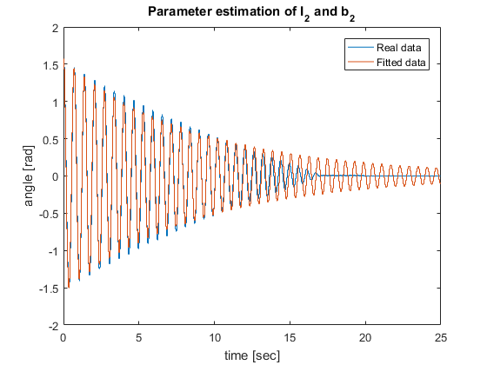
- Physical system
- Black box model
- Simulink model
- Linearisation
- Parameter estimation
- LQR controller
- Kalman filter
- Simulation + visualization
- Demo

Slide 10
Tuning the LQR Controller
Used “dlqr()” in MATLAB
c2d() to discretize system
Sampled at 100Hz
Manually tuned penalties Q and R
Q = diag([1 10000 100000 100 1]);
R = 60000;
Tuned based on step and impulse responses
Step: Low overshoot
Impulse: Fast settling time
Both responses difficult to interpret due to linearized model
- Physical system
- Black box model
- Simulink model
- Linearisation
- Parameter estimation
- LQR controller
- Kalman filter
- Simulation + visualization
- Demo

Slide 11
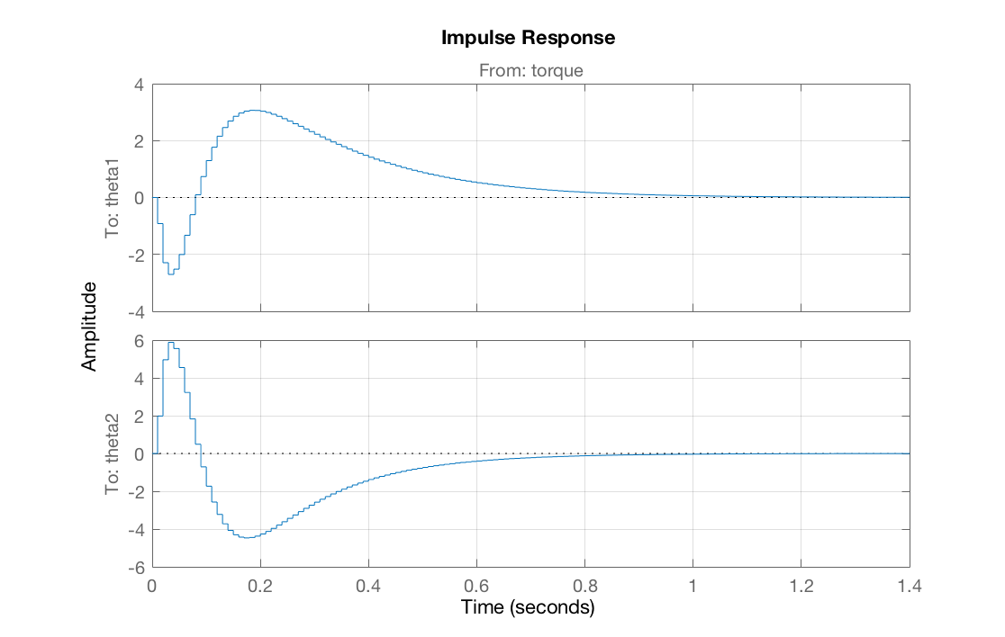
Tuning the LQR Controller
- Physical system
- Black box model
- Simulink model
- Linearisation
- Parameter estimation
- LQR controller
- Kalman filter
- Simulation + visualization
- Demo

Slide 12
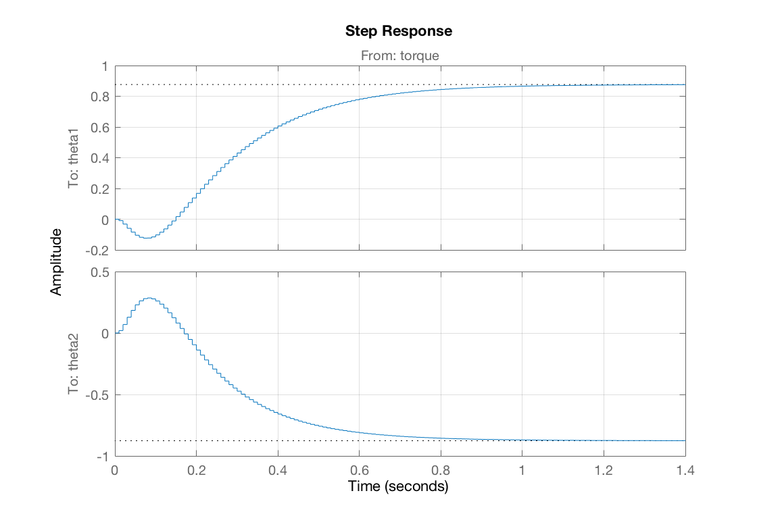
Tuning the LQR Controller
- Physical system
- Black box model
- Simulink model
- Linearisation
- Parameter estimation
- LQR controller
- Kalman filter
- Simulation + visualization
- Demo

Slide 13
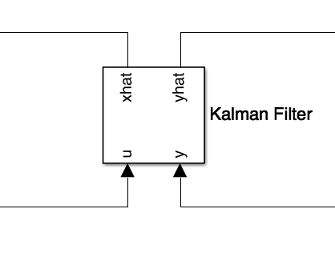
Kalman observer and filter
Observer too time consuming to tune
MATLAB saves the day
Block filters signal and acts as observer
Uses A B C D matrices
Yields very low control effort
- Physical system
- Black box model
- Simulink model
- Linearisation
- Parameter estimation
- LQR controller
- Kalman filter
- Simulation + visualization
- Demo

Slide 14
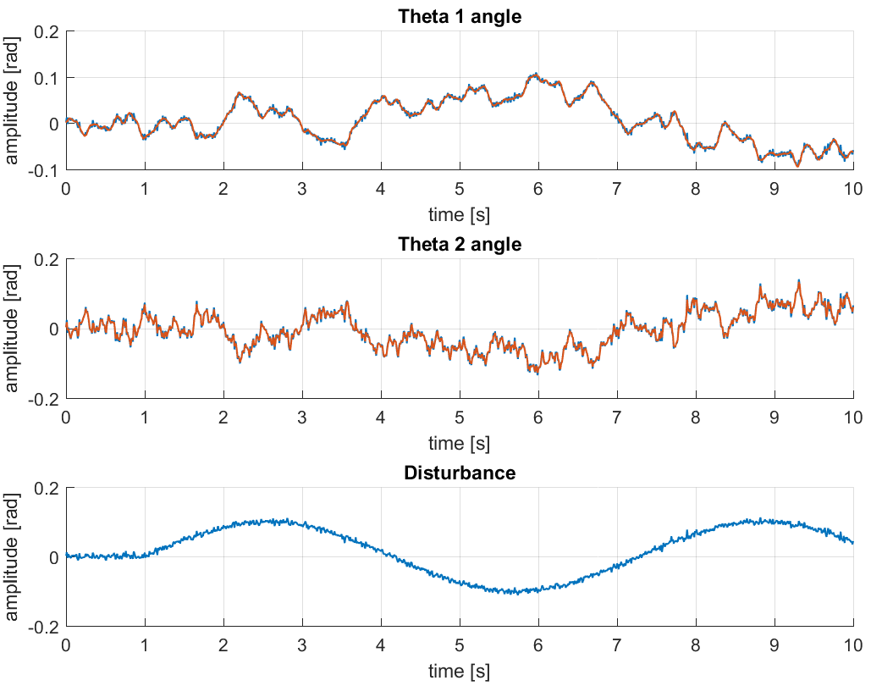
Kalman observer and filter
- Physical system
- Black box model
- Simulink model
- Linearisation
- Parameter estimation
- LQR controller
- Kalman filter
- Simulation + visualization
- Demo

Slide 15
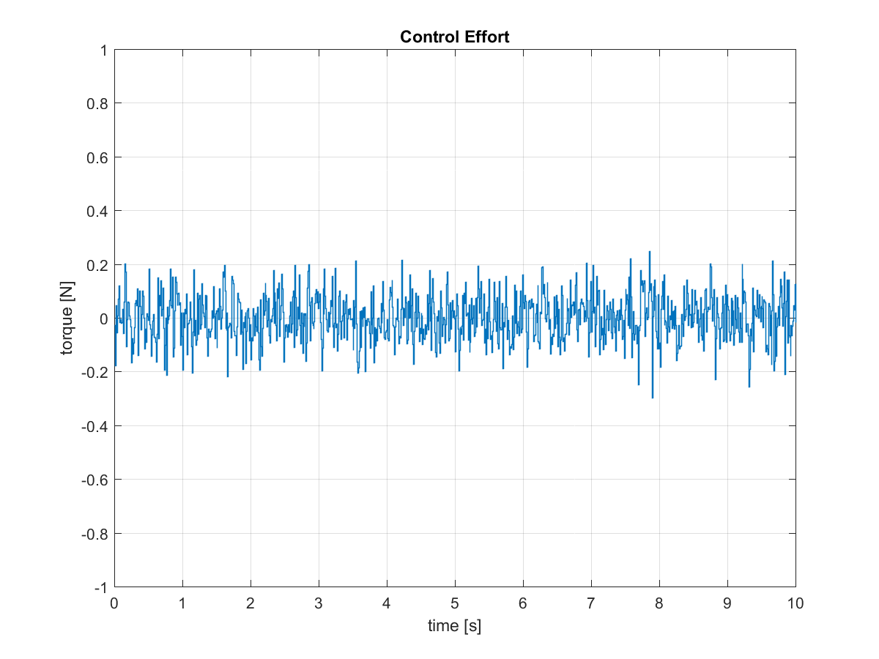
Kalman observer and filter
- Physical system
- Black box model
- Simulink model
- Linearisation
- Parameter estimation
- LQR controller
- Kalman filter
- Simulation + visualization
- Demo

Slide 16
Simulation and Visualization Demo
- Physical system
- Black box model
- Simulink model
- Linearisation
- Parameter estimation
- LQR controller
- Kalman filter
- Simulation + visualization
- Demo

